Slide 1
Analyzing Geospatial Data with Hexagonal Binning
Project Advisor: Dr. David Koop
Presented By: Rishu Vaid

Slide 2
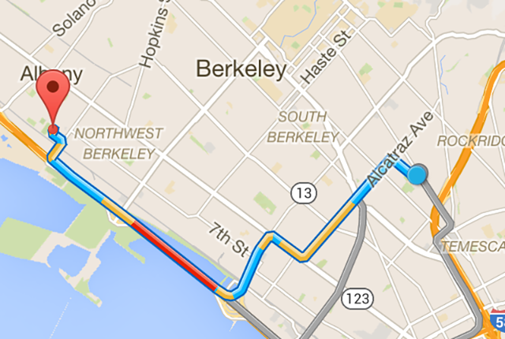
Introduction
Land Maps (Defined Paths)
www.google.com/maps

Slide 3
Ocean Traffic ?
Ocean Data
U.S. Coast Guard collect data with Automatic Identification System (AIS) receivers

Slide 4
Why Ocean Traffic Analysis?
No streets in the ocean. Needs different analysis techniques.
For Example
Planning wind farms in the ocean? Definitely not in Ocean hotspot.
For Safe Navigation (Identify areas of high demand).
Ocean planning for marine life preservation.
Need of:
Meaningful visualization to analyze trends in traffic.

Slide 5
Background Work

Slide 6
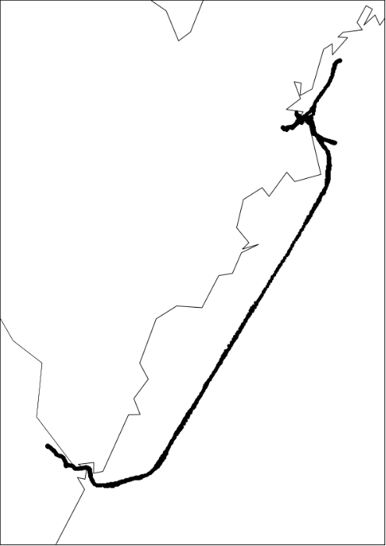
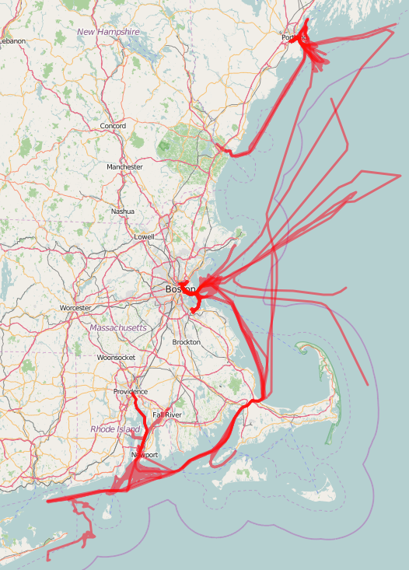
Background work
Points plotted for single voyage
Line paths for 25 voyages

Slide 7
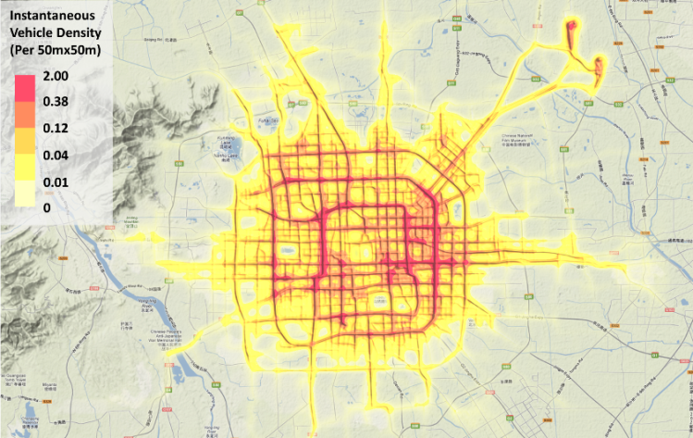
Background Work
Traffic density map of 28,519 Beijing taxis in Mar 8th, 2009
http://vis.pku.edu.cn

Slide 8
Improvement

Slide 9
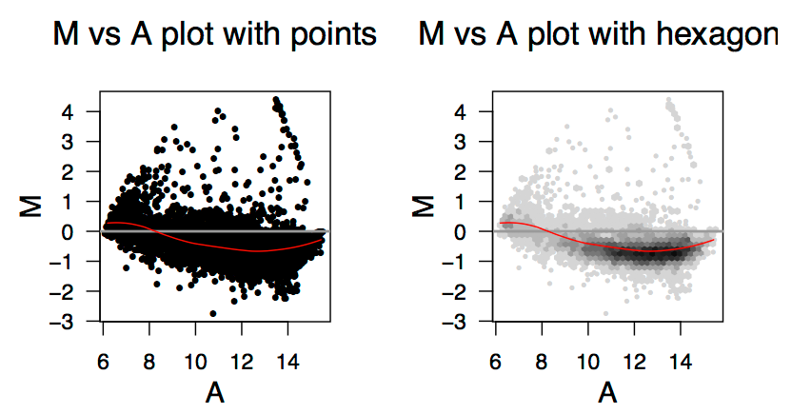
Improved Algorithm (Hexagonal Binning)
(Aids visual communication)
Nicholas Lewin-Koh, 2011

Slide 10
What is Hexagonal Binning?
Surface is tiled with hexagons to create a uniform grid.
No. of points in each bin/tile is calculated and color encoded.
Color of each bin tells the density under the hexbin.
Form of data aggregation.
Efficient for large sets of data.

Slide 11
Why Hexagon and not Square/Triangle?
Grids are compared on their ability to have comparable grid distances to real distances.
Resemblance to reality corresponds to similarity of:
Mapped & actual distance
Areal coverage
Maintenance of angularity & linearity of distance.

Slide 12
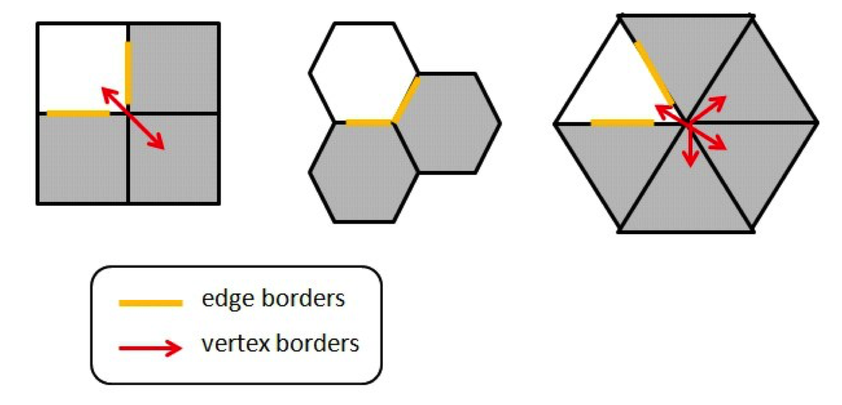
Mapped & Actual distance (Neighbors)
Distance is calculated from centers

Slide 13
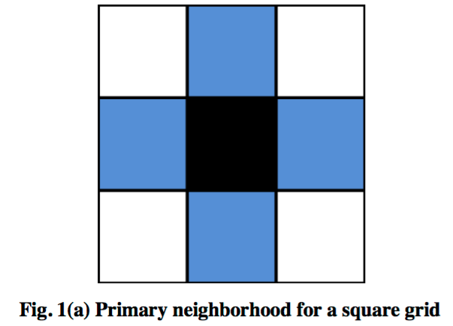
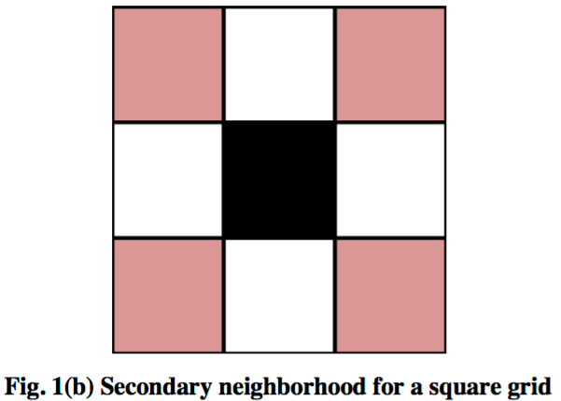
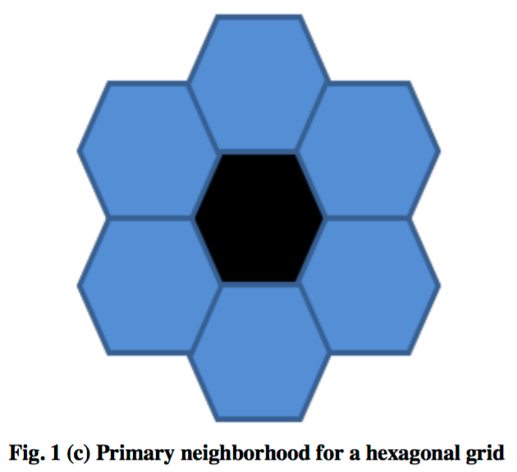
Mapped & Actual distance (Neighbors)
Mapped Distance: 2x
Distance: x
Actual Distance: √2 x
x
x
Result: In square grid, mapped distance
is greater than actual distance with vertex neighbors.
Apte M., Agarwadkar Y. Y.Y., Azmi S., Inamdar A. B. , 2012

Slide 14
Areal Coverage
Square
With same area, hexagon has shorter perimeter than square
Hence, less edge effect with hexagon
Horizontal/vertical lines grab more attention
Maintenance of Angularity
Triangle
Orientation needs to be changed
Thus, calculation is complicated
Apte M., Agarwadkar Y. Y.Y., Azmi S., Inamdar A. B. , 2012

Slide 15
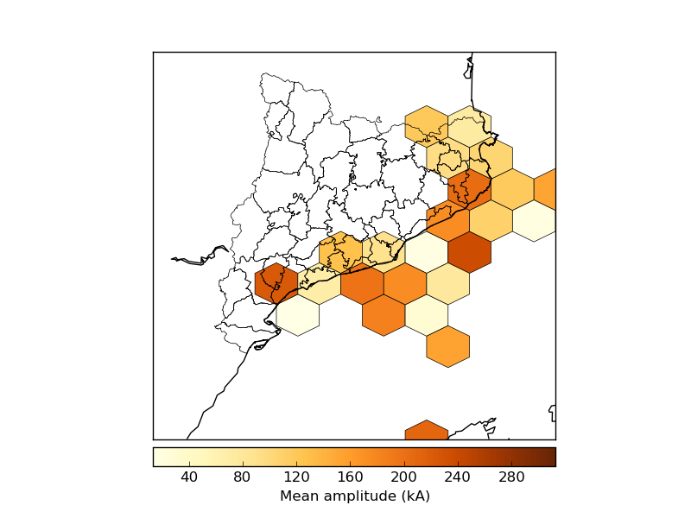
Example of Hexagonal Binning
basemaptutorial.readthedocs.io

Slide 16
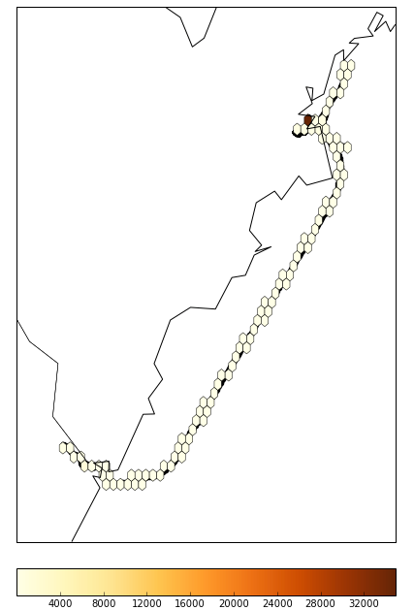
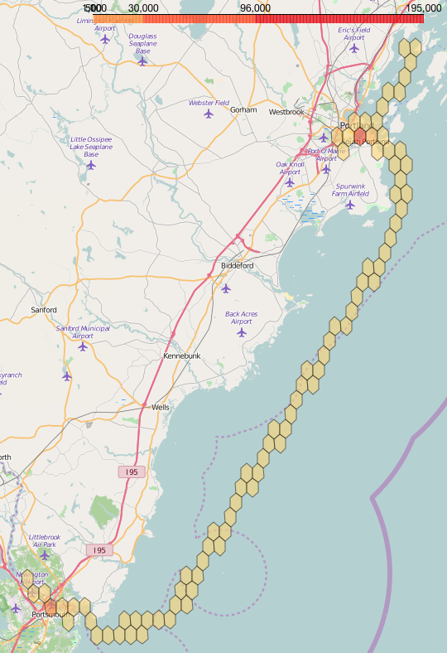
Hexagonal Binning in project
(Initial Work with the algorithm)

Slide 17
PROJECT DATA

Slide 18
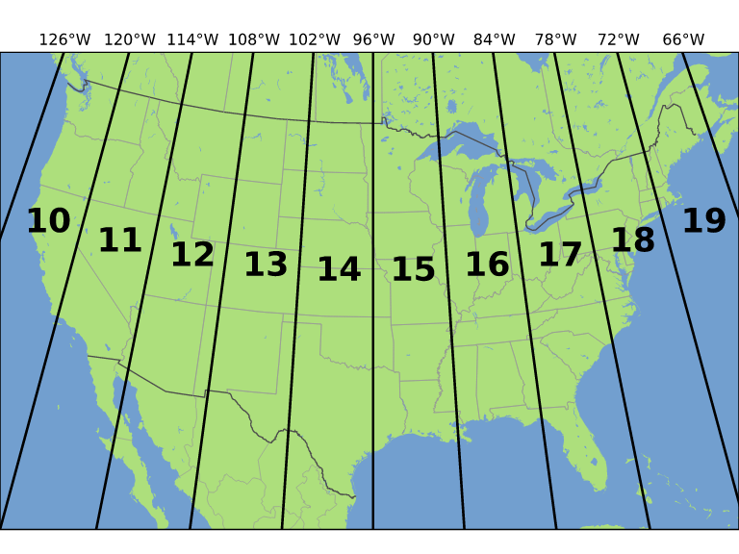
UTM Zones
genealogysstar.blogspot.com

Slide 19
Ocean Traffic Data Collection
Data Source: marinecadastre.gov
Vessel Traffic data
Recorded at 1 min interval (Latitude, Longitude)
File Geodatabase (.gdb) format

Slide 20
File Geodatabase Structure (gdb)
Geometry
(Lat, Lon)
Layers Features
(Table) (Rows)
Fields
(Column Values)

Slide 21
Layers
Broadcast (Used in Project)
Contains position reports
Voyage
Static data for each voyage
Vessel
→ Static data for vessels

Slide 22
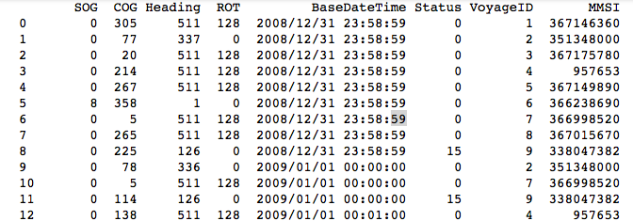
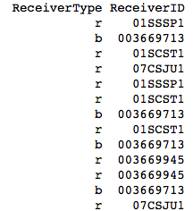
Broadcast layer
FIELDS
Geometry
Latitude
Longitude
Speed over Ground (SOG)
Course over Ground (COG)
Rate of Turn (ROT)
Marine Mobile Service Identity (MMSI)

Slide 23
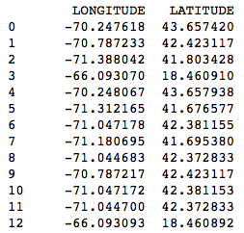
Broadcast Layer
GEOMETRY

Slide 24
Data Fields Used
Voyage Id
Geometry (latitude, longitude)
BaseDateTime

Slide 25
Tools Used
Language
Python
Data Extraction
Geospatial Data Abstraction Library (GDAL)
OpenGIS Spatial Reference System (OGR)
Data Manipulation
Basemap
Matplotlib
Pandas
Data Rendering
Folium

Slide 26
Dimensions of the project
Traffic density
Traffic Direction

Slide 27
Traffic Density

Slide 28
Approach Used for Traffic Density
Data extracted with GDAL & OGR
Coordinates grouped by VoyageID
Fields
Dictionary with VoyageId as keys & coordinates as values
data.gdb
Spatial Filter applied
Lat,Lon
DataFrame
[HexId,Count]
Hexbin of each voyage
Build dataframe with unique ids of hexagon with counts
Extract geometry of hexagons from single voyage & associate count of unique no. of voyages to each hexagon
Fed to Folium for display
.geojson file of geometry of hexagons & counts
Dictionary with VoyageId as keys & ‘hexbins with their counts’ as values
Leaflet Map

Slide 29
Filters Used
Spatial filters
extract out the subset of data within minimum and maximum spatial longitude & latitude points provided
Example:
layer.SetSpatialFilterRect(-71.1461, 42.5662, -70.2974, 42.0880)
Attribute filters
extract out the subset of data that matches the attribute condition provided
Example:
layer.SetAttributeFilter("VoyageID < ‘100'")
BaseDateTime filters
extract out the subset of data that was recorded in the time interval provided
Example:
layer.SetAttributeFilter("BaseDateTime > '2008/12/31 00:00:00' AND BaseDateTime < '2009/01/08 00:00:00'")

Slide 30
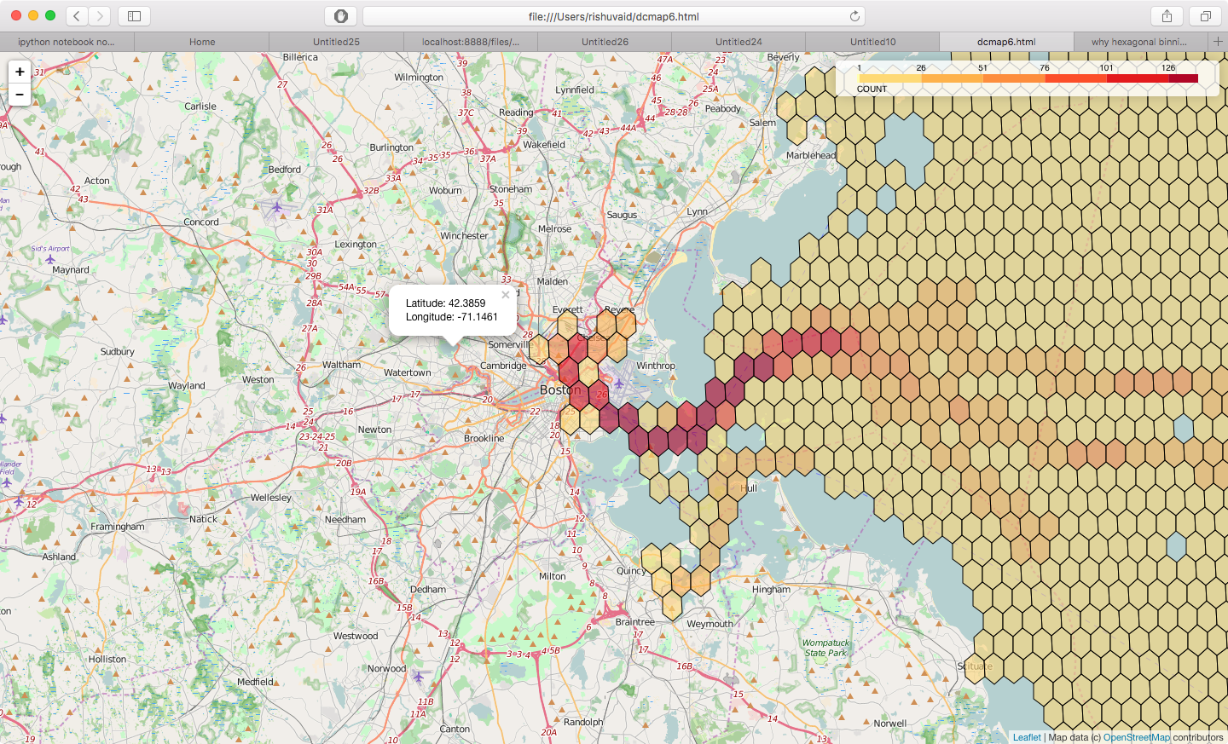
Boston Region

Slide 31
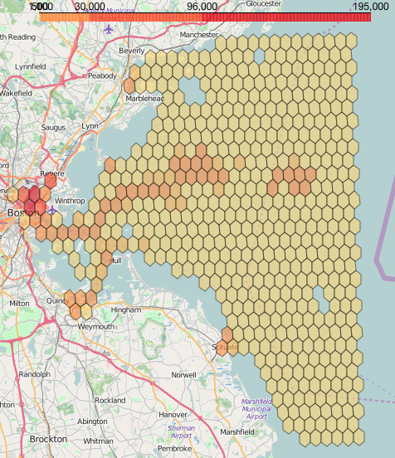
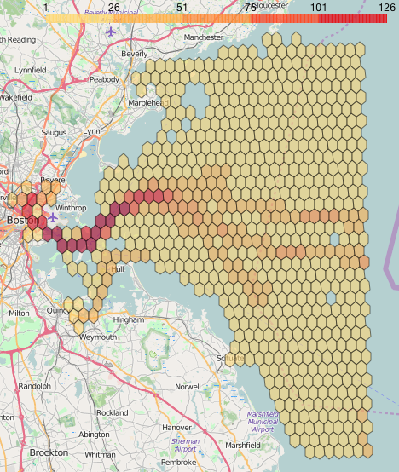
Approach
Counts points per hexbin
Counts voyages per hexbin

Slide 32
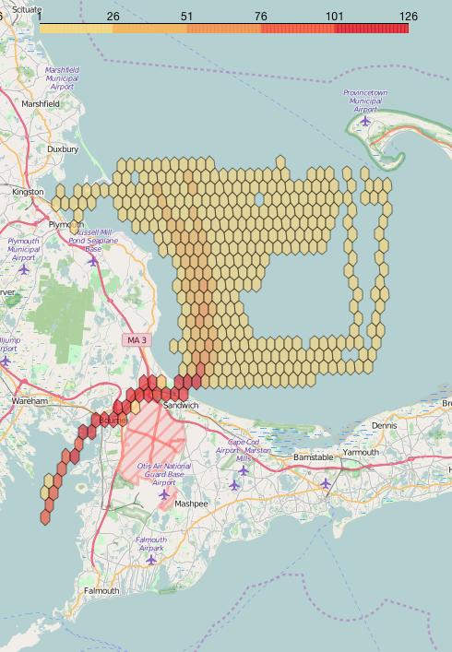
Plymouth Region

Slide 33
Traffic Direction

Slide 34
Approach Used for Traffic Direction
Data extracted with GDAL & OGR
Fields
Hexbin of data
.geojson file of geometry of hexagons & 4 counts with value 0
data.gdb
Spatial Filter applied
Lat,Lon
Coordinates grouped by VoyageID
Dictionary with VoyageId as keys & coordinates as values
DataFrame
[HexId,Count]
Build dataframe with unique ids of hexagon with counts
1) For each voyage compare every 2 consecutive points.
2) Find if any line (joining 2 points) intersects with any hexagon from geojson.
3) If yes, get bearing value of line.
4) Increment the count associated to hexagon corresponding to bearing direction
Fed to Folium for display
.geojson file of geometry of hexagons & 4 counts
Leaflet Map

Slide 35
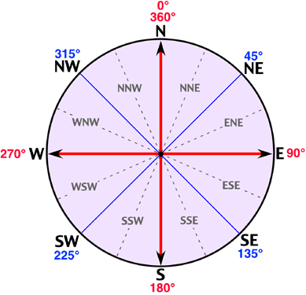
Bearing & Direction
www.physicalgeography.net

Slide 36
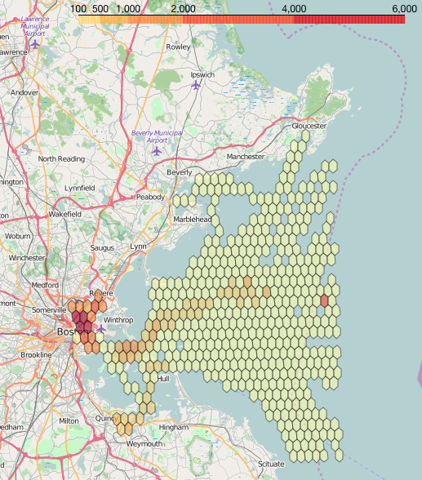
Traffic Direction Snapshot
North-East
N
W
E
S

Slide 37
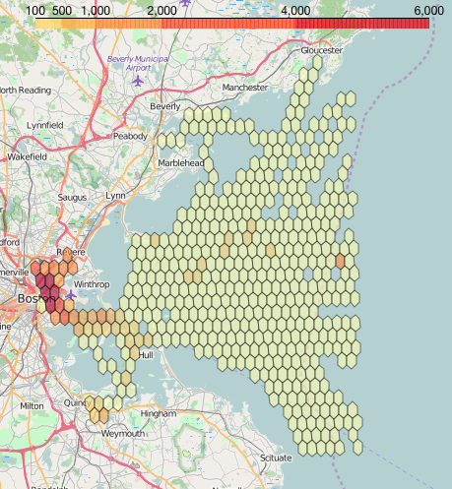
Traffic Direction Snapshot
East-South
N
W
E
S

Slide 38
Demo

Slide 39
Future Scope
Improvement in Computation time.
Exploring more techniques for direction analysis.

Slide 40
Questions?

Slide 41
Thank You!

